Slide 1
Cumulative landscape effects on fish contamination across managed boreal forests
Brian Kielstra Cumulative Effects Research Scientist, Canadian Forest Service
GLFC Seminar, February 4 2022

Slide 2
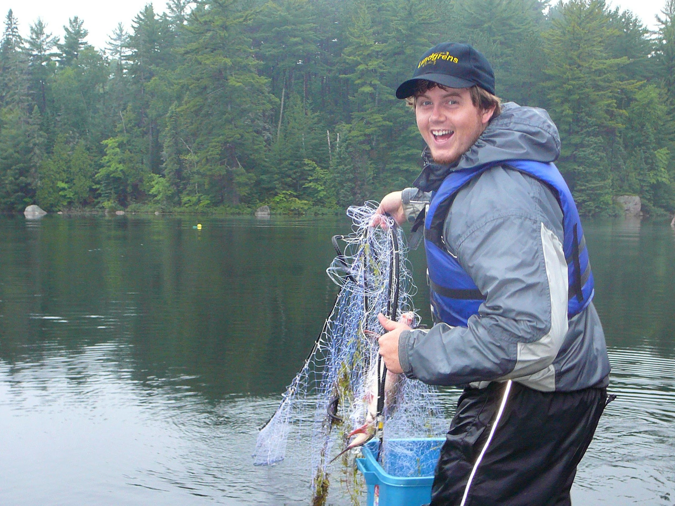
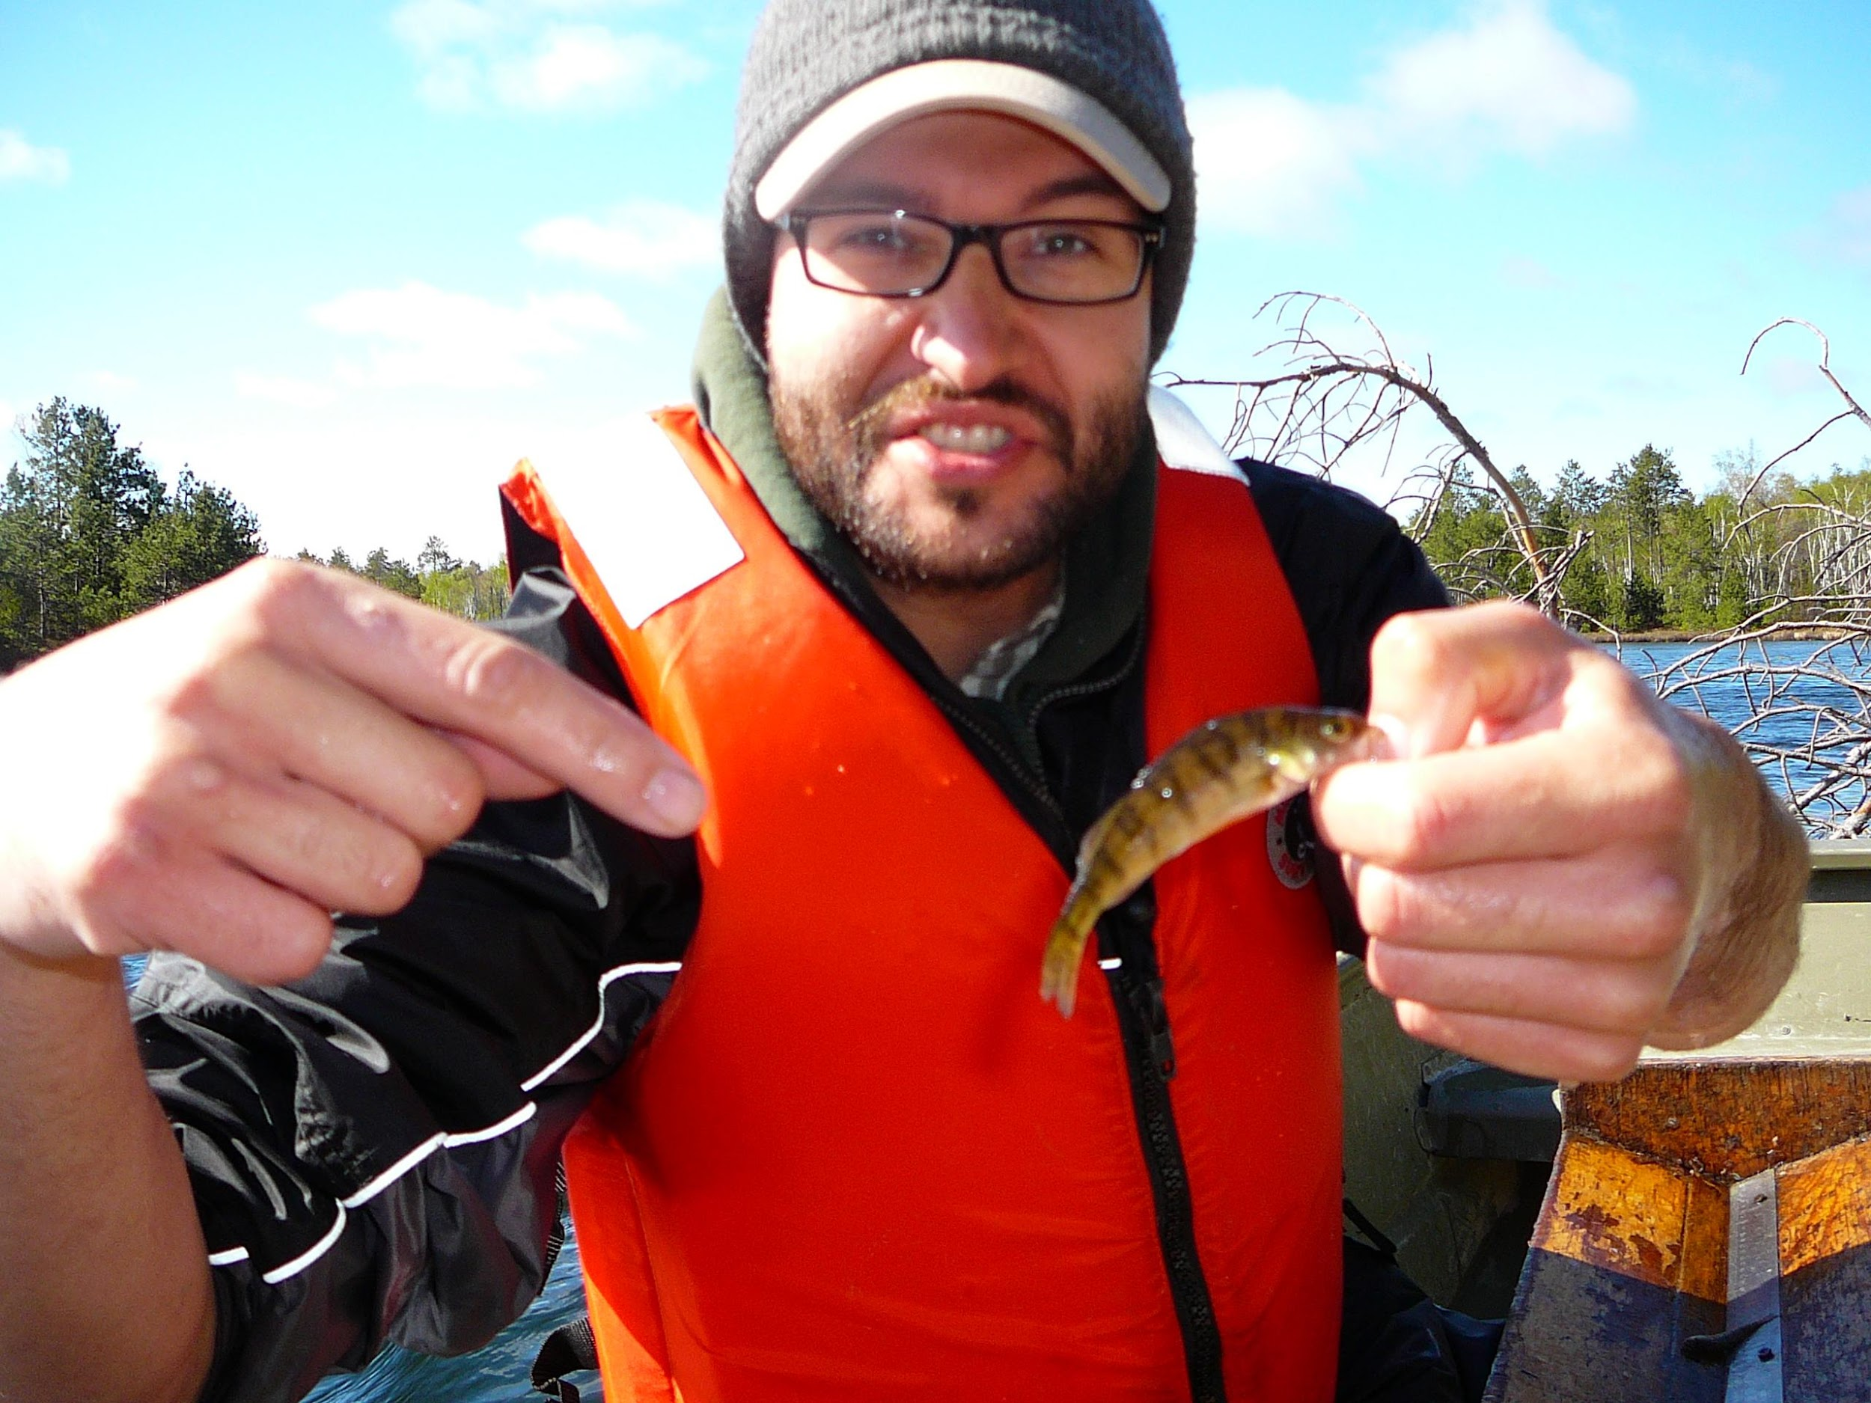
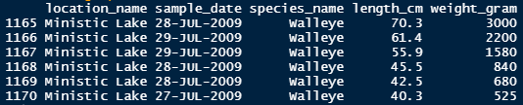
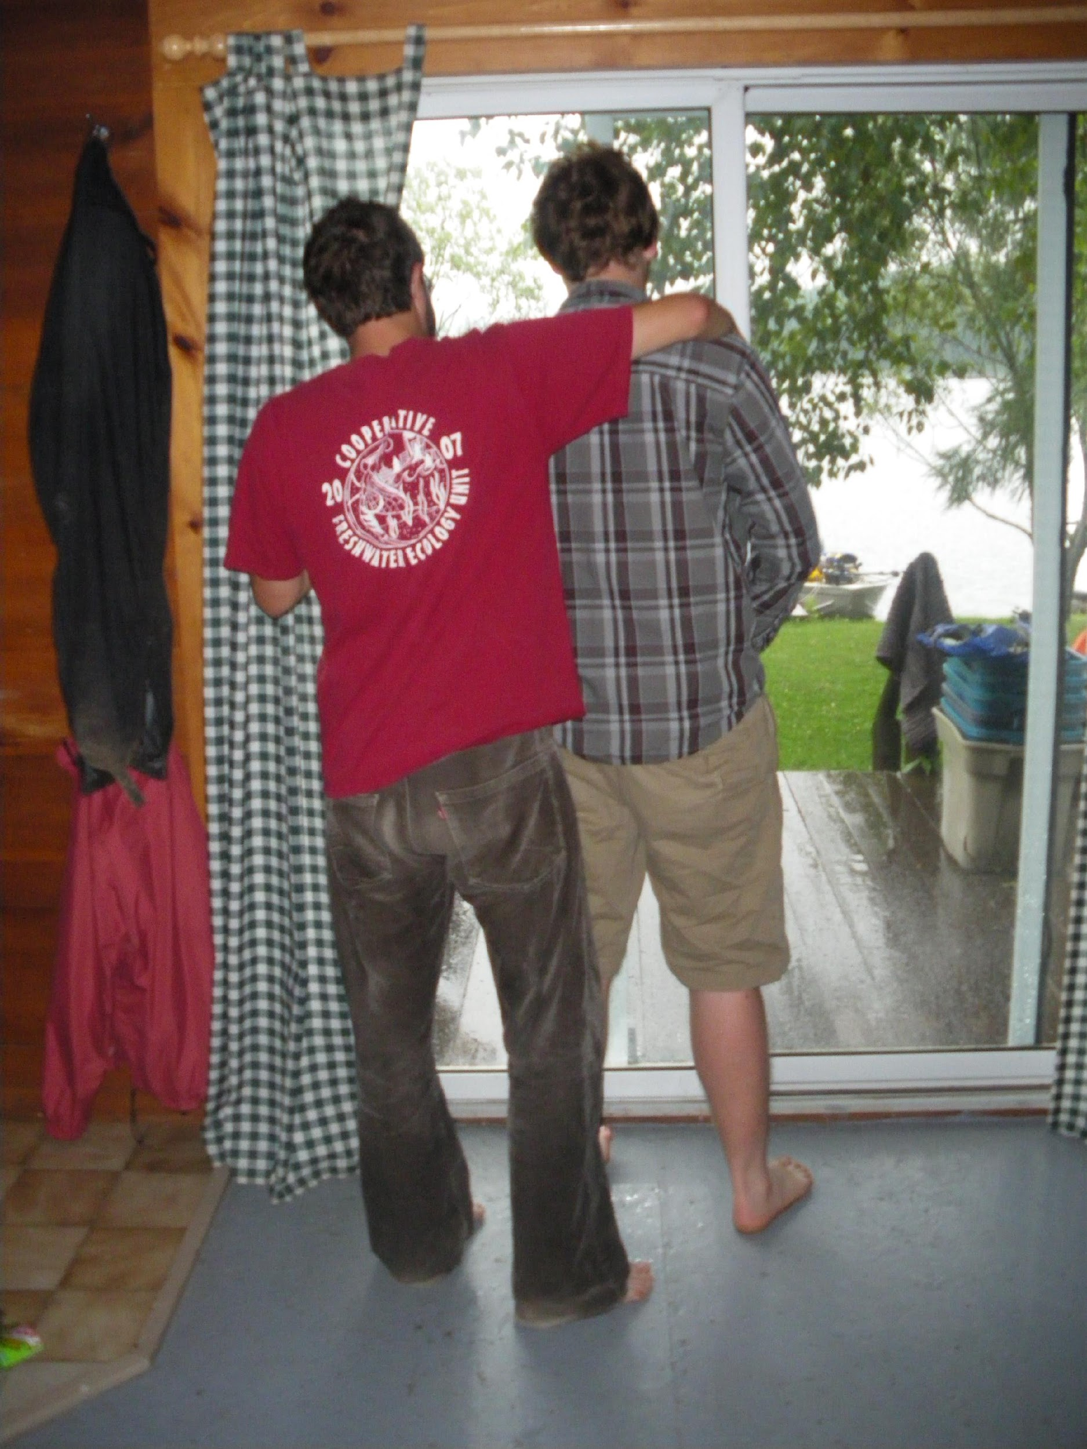
Field work
Significant effort put into field sampling for contaminants from fish ($$$, time)
“Dr.” Brian Kielstra and “Dr.” Erik Emilson
sampling BSM lakes in 2009
Notes:
Opportunistic sampling and budgets limit the amount of samples available to estimate/understand contaminant concentrations at the waterbody level.

Slide 3
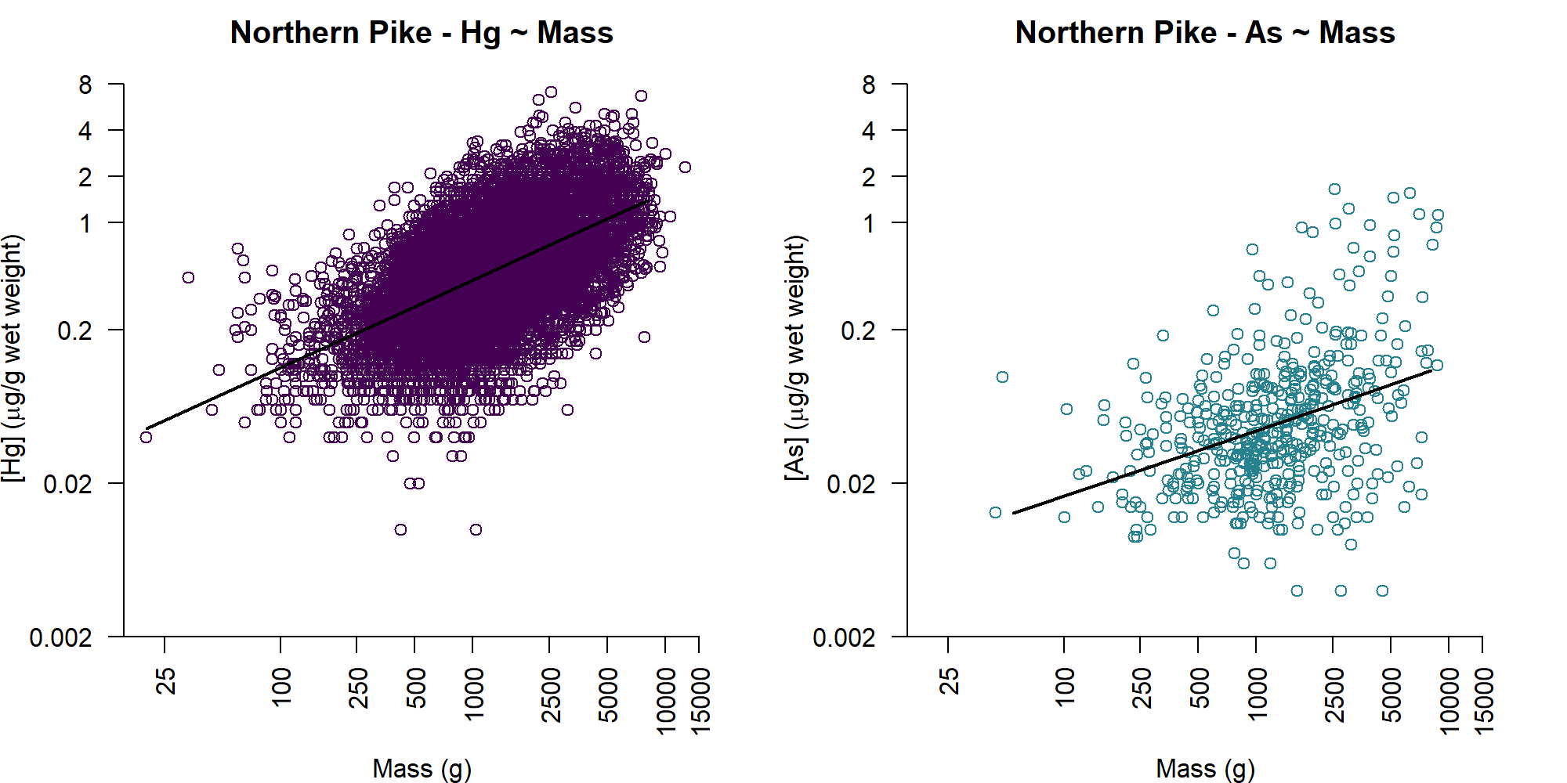
Contaminant comparison challenges
“Opportunistic sampling”/budgets limit samples for estimating at waterbody-level
Comparing lakes - use average? size-based due to contaminant-size relationships?
Notes:
Opportunistic sampling and budgets limit the amount of samples available to estimate/understand contaminant concentrations at the waterbody level.

Slide 4
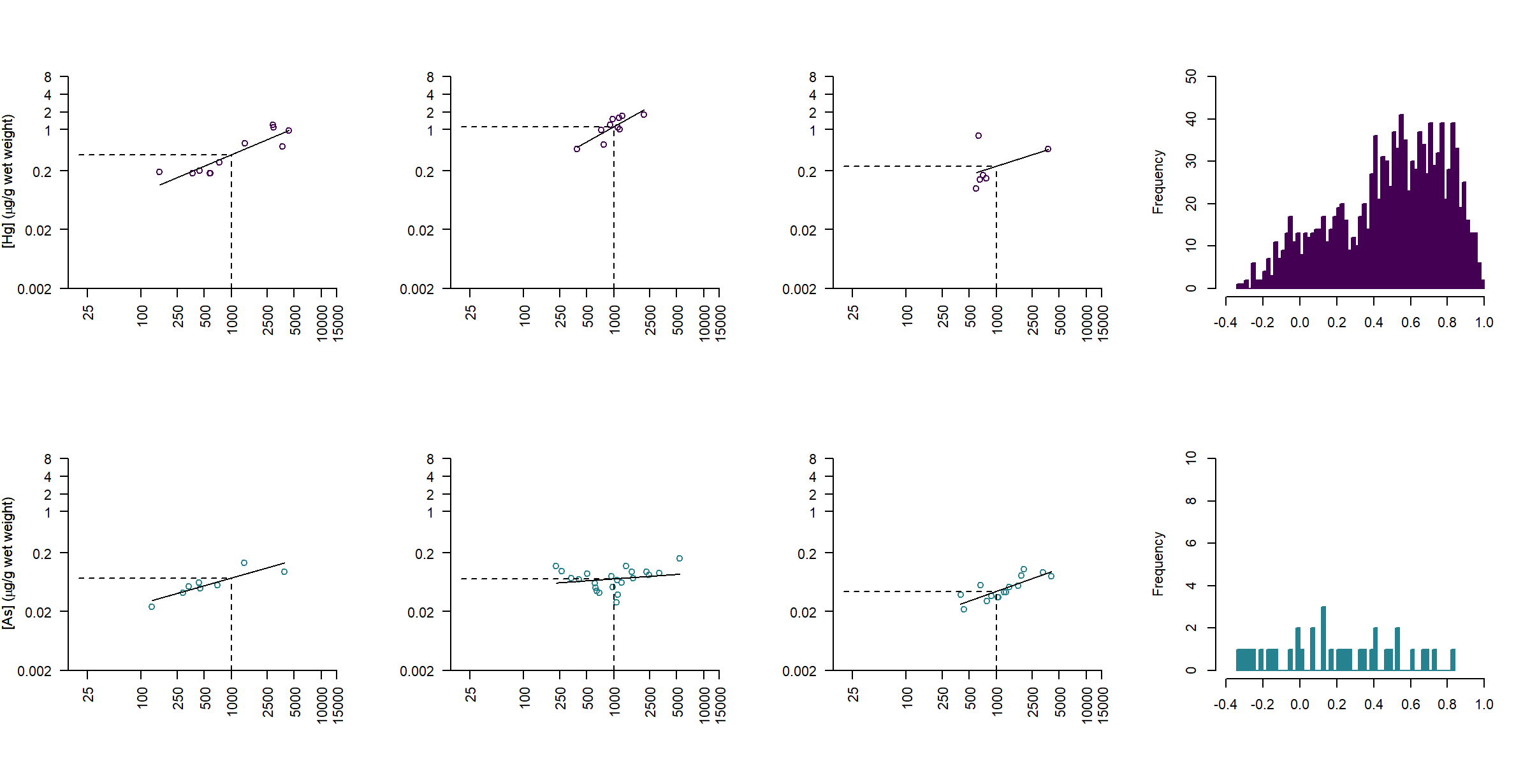
Standardized comparisons
Hg
Lake-level regressions, predicting to 1000 g fish
R² distribution
As

Slide 5
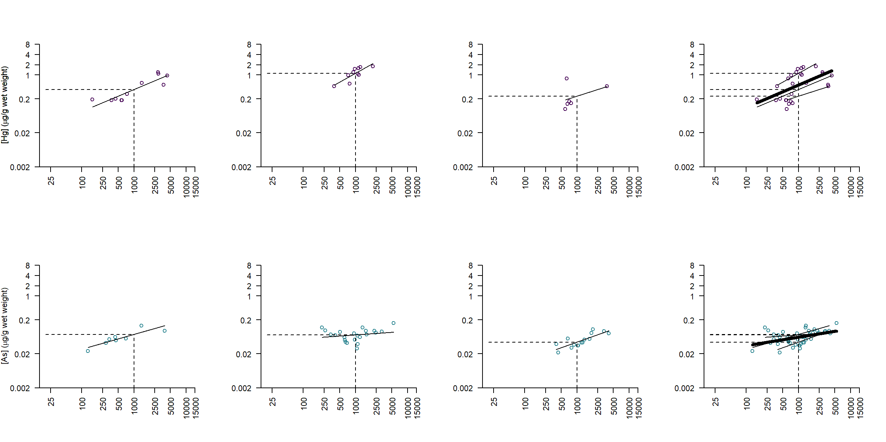
Standardized comparisons
Hg
Lake-level regressions, predicting to 1000 g fish
Mixed effects models
As
Notes:
Adventageous

Slide 6
Standardized comparisons, mixed models
Hg
Mixed effects models advantages:
“Borrow strength” from other observations in fitting/prediction
If body size relationship weak, predicts an average
Increased understanding of sampling structural variation
(i.e., between lakes, between years)
As
Notes:
Opportunistic sampling and budgets limit the amount of samples available to estimate/understand contaminant concentrations at the waterbody level.

Slide 7
Standardized comparisons, mixed models
Hg
Some models better from practical perspective (the Goldilocks approach):
Maximum likelihood (R’s lmer; ML):
“This model is too fast, but doesn’t account for random effects without bootstrapping, and even then it only bootstraps the residual error without errors”
MCMC Bayesian (Stan through R’s rstanarm; MB):
“This model is too slow, but accounts for random effects”
Approximate Bayesian (INLA through R’s RINLA; AB):
“This model is just right?”
As
Notes:
Opportunistic sampling and budgets limit the amount of samples available to estimate/understand contaminant concentrations at the waterbody level.

Slide 8
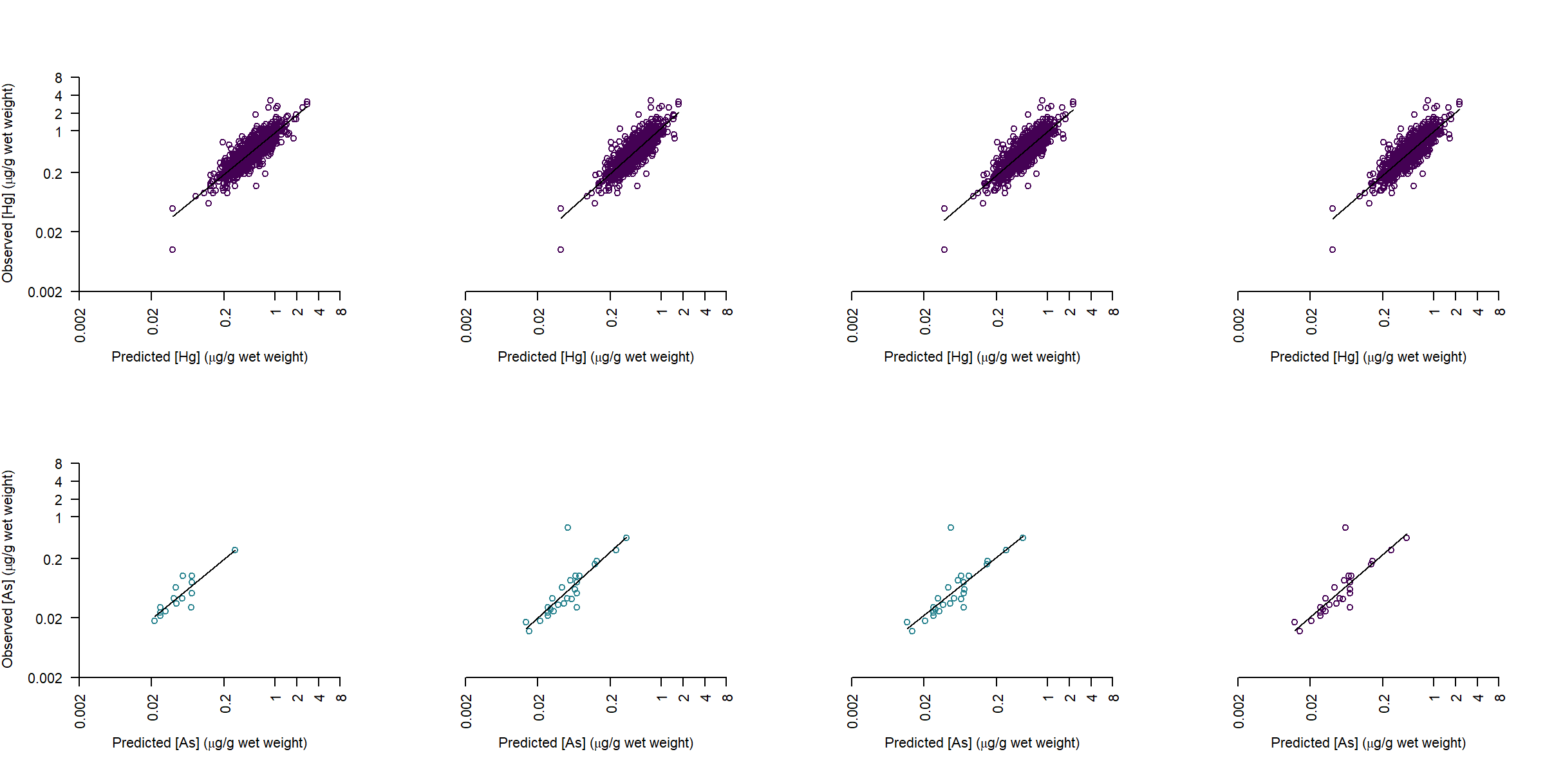
Standardized comparisons, prediction accuracy
Hg
SER: 0.74
ML: 0.71
AB: 0.72
MB: 0.72
Compares all 1000 g +/- 50 g observations with 1000 g predictions; consistency across approaches
As
SER: 0.76
ML: 0.67
AB: 0.65
MB: 0.71
Notes:
Opportunistic sampling and budgets limit the amount of samples available to estimate/understand contaminant concentrations at the waterbody level.

Slide 9
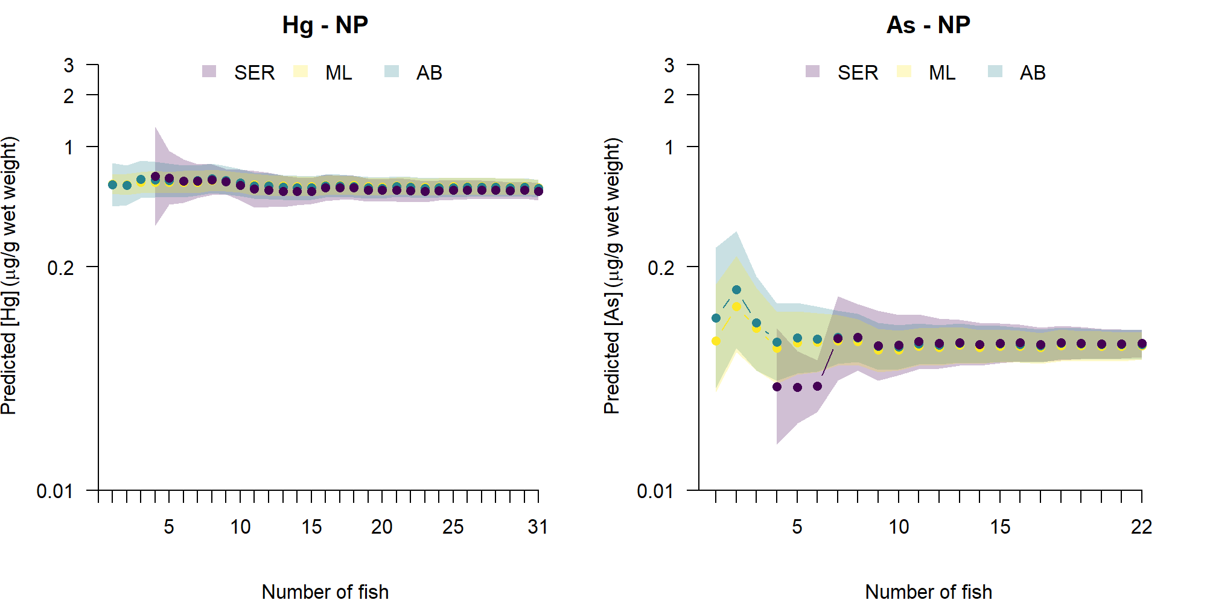
Standardized comparisons, precision
1
2
3
1
2
3
Notes:
Opportunistic sampling and budgets limit the amount of samples available to estimate/understand contaminant concentrations at the waterbody level.

Slide 10
Increased understanding of structural variation
Model | R² fixed | R² random (total) | Between-lake Intercept | Between-lake Slope | Between Events
Hg – Lk. Trout | 0.31 | 0.54 (0.85) | 1.46 | 0.16 | 0.12
Hg – N. Pike | 0.35 | 0.45 (0.80) | 0.99 | 0.12 | 0.11
Hg – Walleye | 0.38 | 0.47 (0.85) | 1.27 | 0.14 | 0.14
As – Lk. Trout | 0.06 | 0.64 (0.70) | 1.05 | 0.16 | 0.00
As – N. Pike | 0.08 | 0.74 (0.83) | 0.79 | 0.21 | 0.20
As – Walleye | 0.04 | 0.69 (0.73) | 0.95 | 0.15 | 0.08
Intercept >> Slope ~ Events
Body-size relationship
Body-size relationship + between-waterbody
DIFFERENCES BETWEEN WATERBODIES IS MOST IMPORTANT!
Notes:
Opportunistic sampling and budgets limit the amount of samples available to estimate/understand contaminant concentrations at the waterbody level.

Slide 11
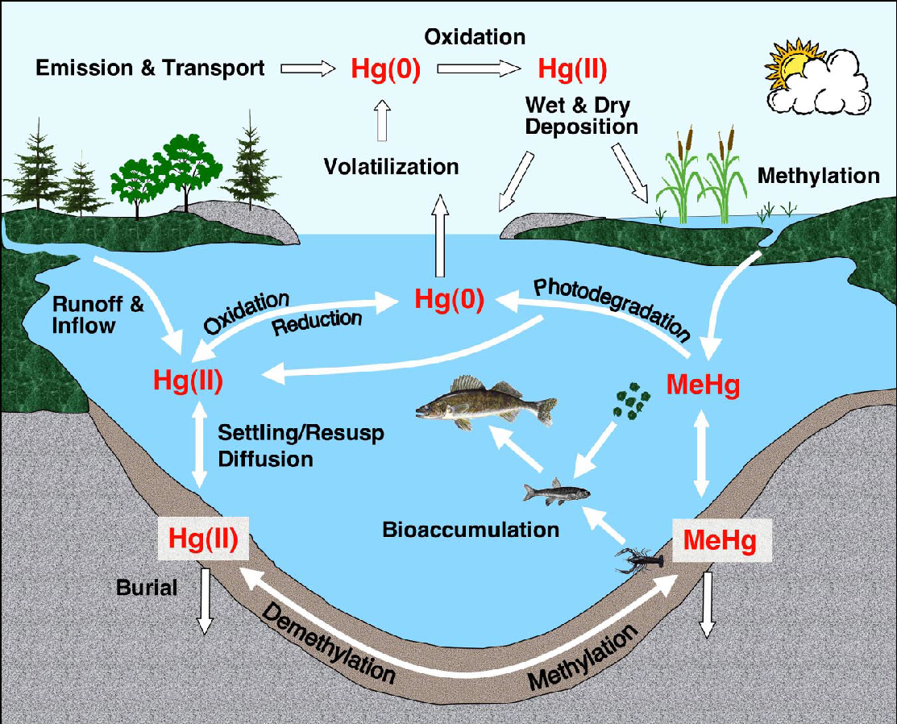
Landscape effects on mercury in fish
Mercury (Hg) is a global contaminant (natural and anthropogenic)
– travels long distances and enters ecosystems through several paths
– more recent focus on catchment-mediated inputs and organic matter interactions
e.g.,
deposition and catchment-mediated
Bishop et al. 2020; Branfireun et al. 2020; Engstrom 2007

Slide 12
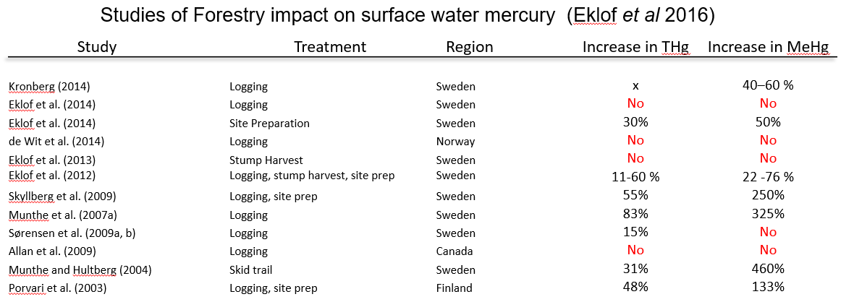
Landscape effects on mercury in fish
Impact of forest harvesting? Limited by # of studies and sample size
– not clear how it compares with climate, fire, pest, etc. effects
Emilson presentation (2019) w/ Eklöf (2016) data

Slide 13
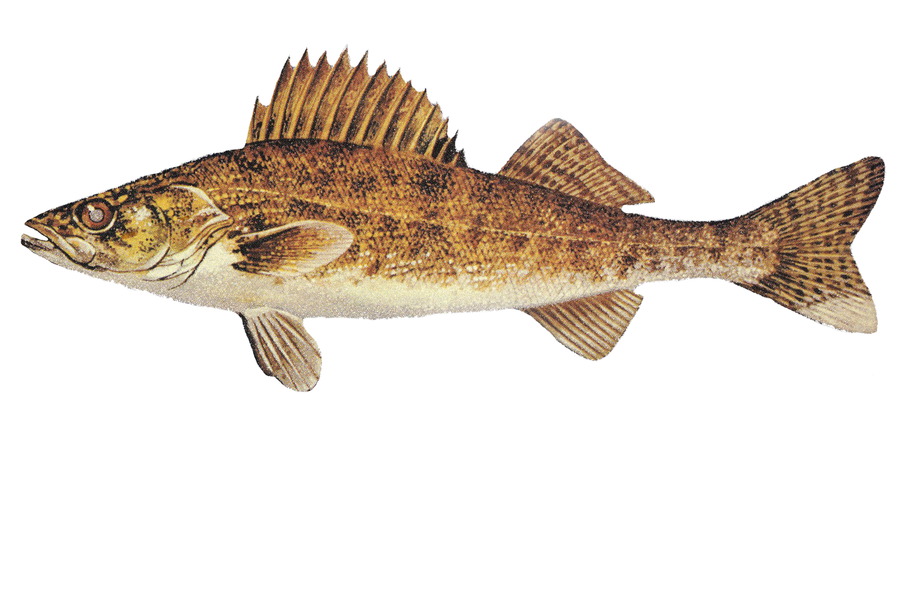
Landscape effects on mercury in fish
Cumulative effects are complex, comprehensive, and multiscale
Mercury concentration
life history, water chemistry, food sources, other biotic interactions
Catchment characteristics (i.e., what materials? how delivered??)
Landscape context (e.g., where does the lake fit?)
Unmeasured spatial variation (e.g., what variables/scales are we missing?)
Notes:
Lisa citation and Jones 2017

Slide 14
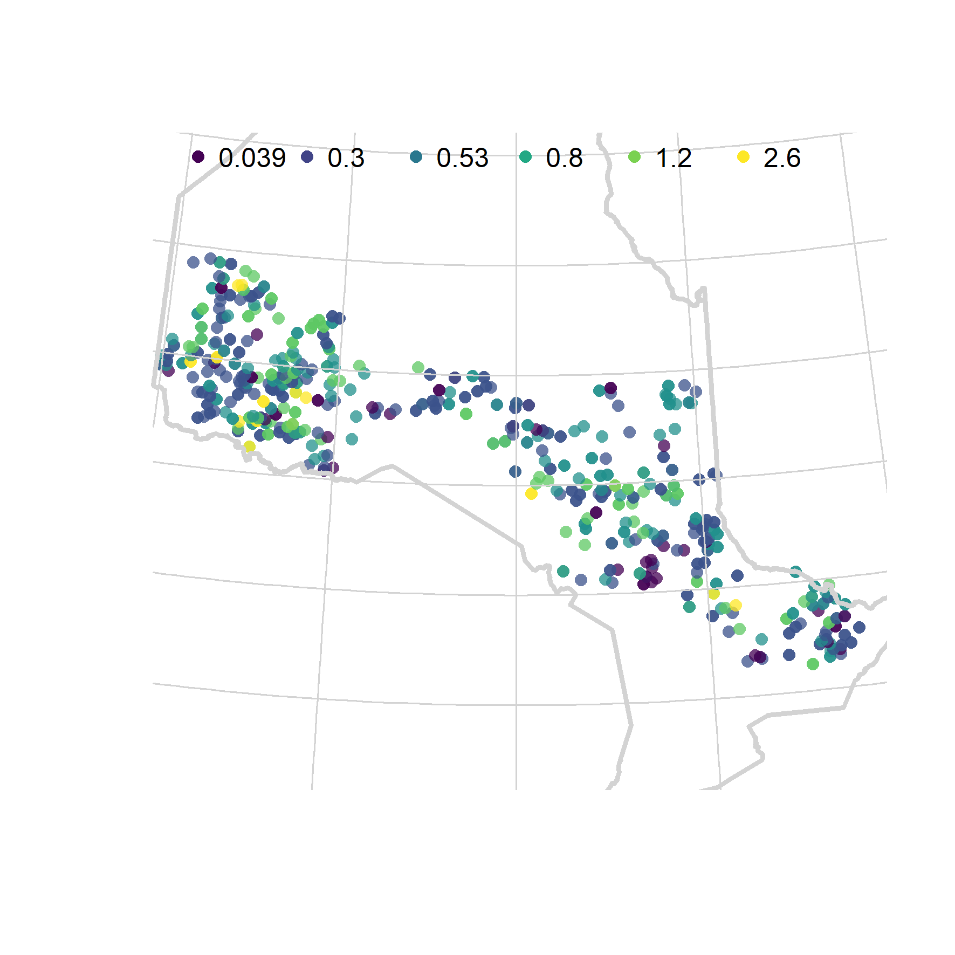
Landscape effects on mercury in fish
What explains differences between lakes?
Catchment characteristics?
Landscape context?
Unmeasured spatial variation?
e.g., Wet weight Hg predictions (µg/g) for median-sized Walleye across AOU lakes

Slide 15
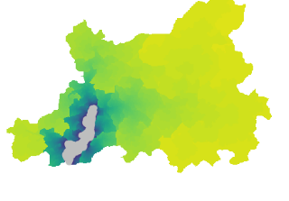
Landscape effects on mercury in fish
Aquatic ecosystems are integrators of their upstream catchment
and particularly suited for cumulative effects studies
Catchment
Flow
Lake

Slide 16
Landscape effects on mercury in fish
Aquatic ecosystems are integrators of their upstream catchment
and particularly suited for cumulative effects studies
Forest fire

Slide 17
Landscape effects on mercury in fish
Aquatic ecosystems are integrators of their upstream catchment
and particularly suited for cumulative effects studies
Forest fire
Notes:
Impacts on aquatic ecosystems focal points of cumulative effects – as a natural pour point

Slide 18
Landscape effects on mercury in fish
Aquatic ecosystems are integrators of their upstream catchment
and particularly suited for cumulative effects studies
Forest fire
Notes:
Impacts on aquatic ecosystems focal points of cumulative effects – as a natural pour point

Slide 19
Landscape effects on mercury in fish
Aquatic ecosystems are integrators of their upstream catchment
and particularly suited for cumulative effects studies
Forest fire
Harvest
Wetland
Notes:
Impacts on aquatic ecosystems focal points of cumulative effects – as a natural pour point

Slide 20
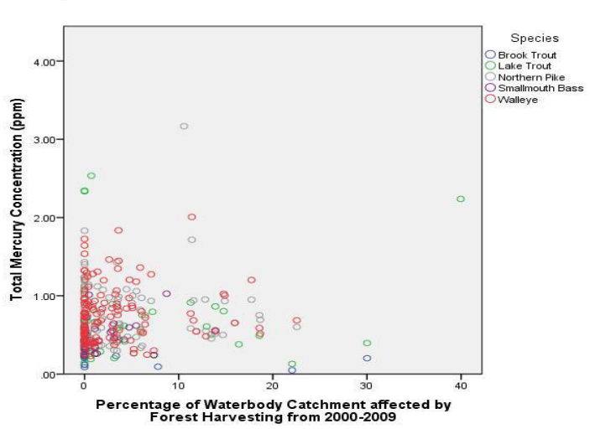
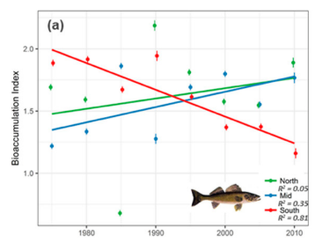
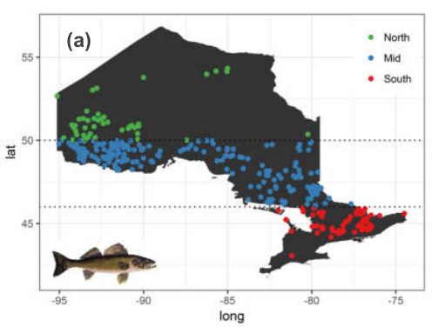


Landscape effects on mercury in fish
Building on previous work at broader scales
What lake- and landscape-scale features associated with Hg in fish?
Danco (2013)
Thomas (2018)
Mackereth ( )
Melles ( )

Slide 21
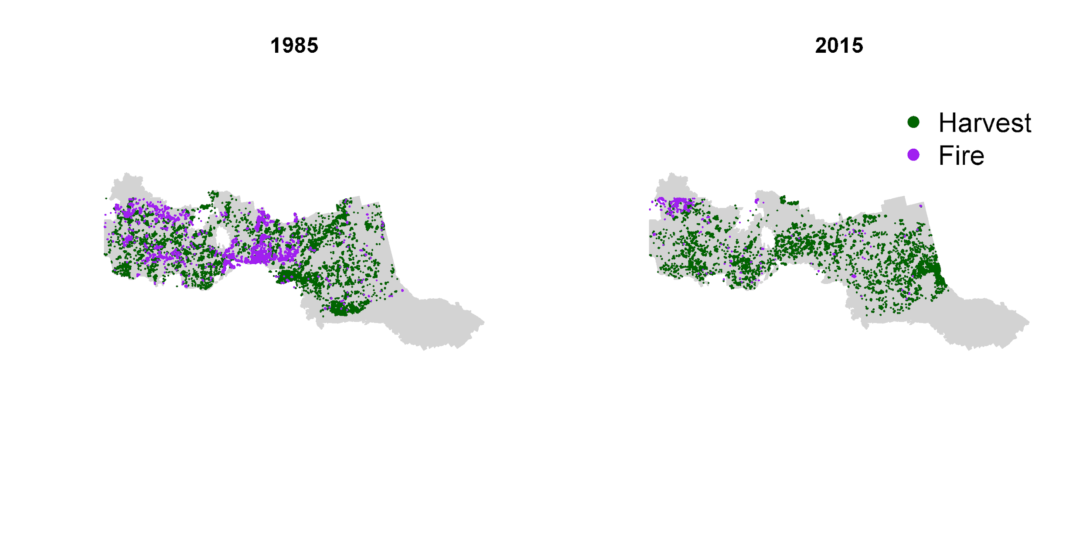
Landscape effects on mercury in fish
Unique opportunity to link new and big fish mercury and catchment disturbance databases
Fish: 2008–present (5 year cycles)
Fire/harvest/insects: 1972–present (annual)
>600 lakes
Fish: Ontario Ministry of Natural Resources and Forestry
Mercury: Ontario Ministry of the Environment, Conservation and Parks
Disturbance: Ontario Ministry of Natural Resources and Forestry

Slide 22
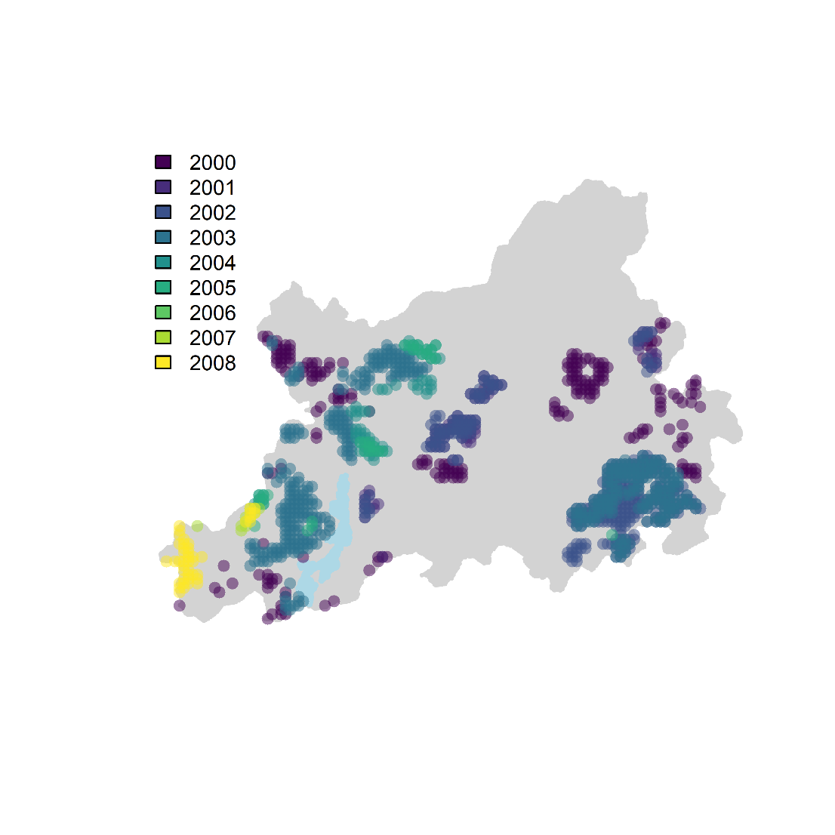
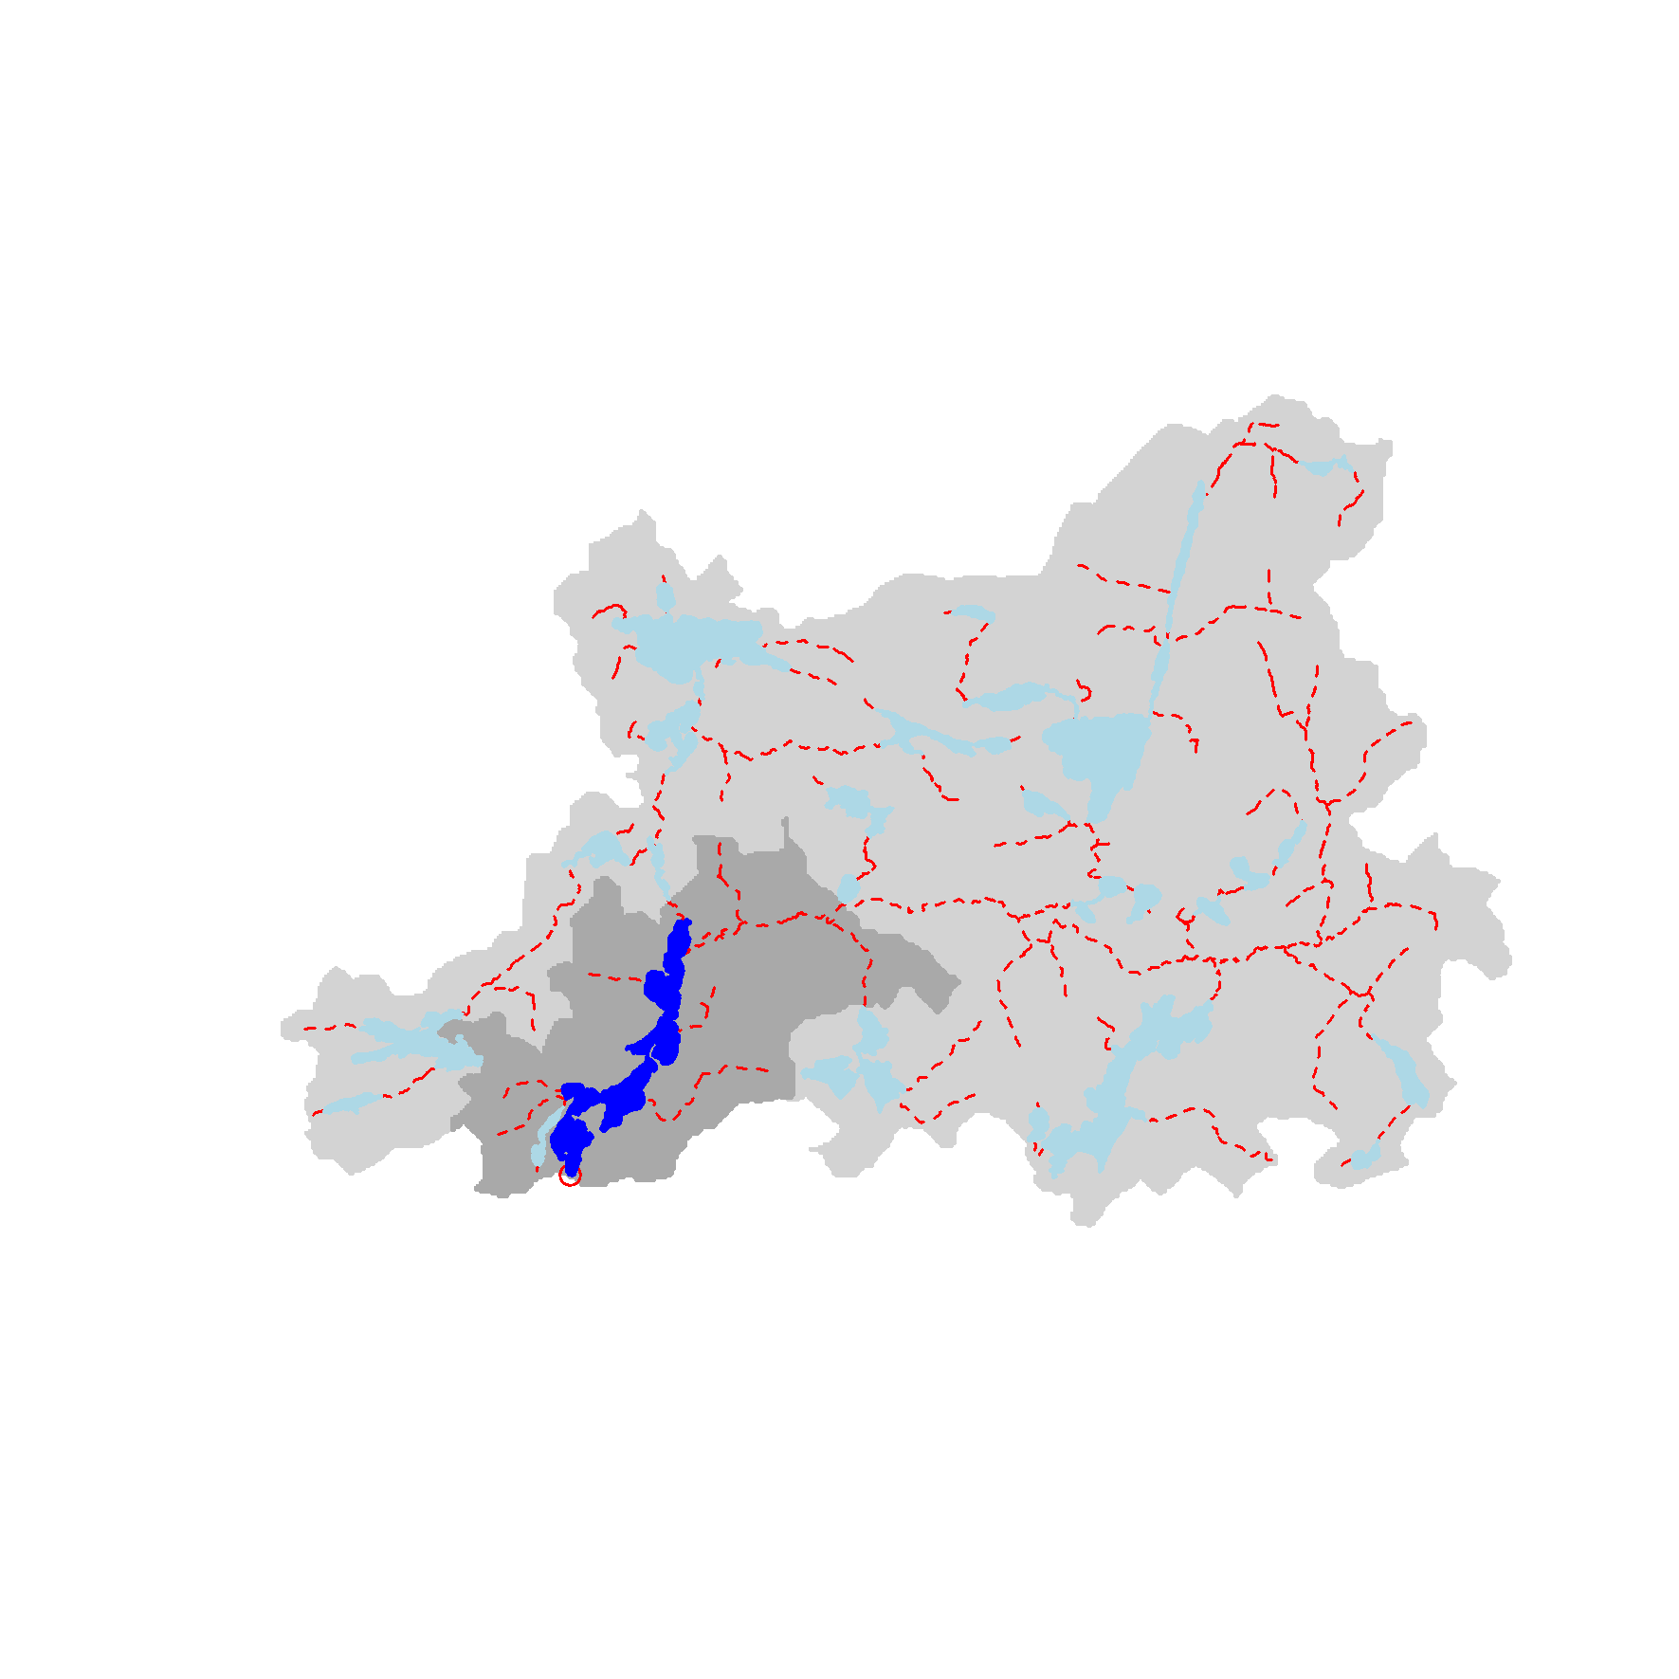
Landscape effects on mercury in fish
Catchment characteristics (i.e., what materials? how delivered?)
Mercury concentration
Landscape context (e.g., where does the lake fit?)
Unmeasured spatial variation (i.e., what variables/scales are we missing?)
Notes:
Fish, Turn examples into questions

Slide 23
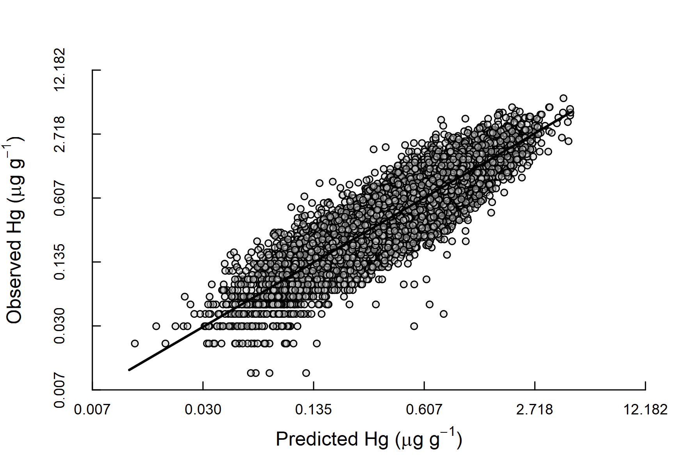
Research approach – Mercury concentration
Modelled/predicted variable:
Hg_{Fish (μg/g)} of standardized length/mass
for a given waterbody
in a given year
Leverage ~22000 fish records into Bayesian mixed model
Notes:
For the data nerds; not a trivial step and a huge amount of work to line up datasets difficult to make them communicate

Slide 24
Research approach
Catchment characteristics (i.e., what materials? how delivered?)
Mercury concentration
Landscape context (e.g., where does the lake fit?)
Unmeasured spatial variation (i.e., what variables/scales are we missing?)
Notes:
Fish, Turn examples into questions

Slide 25
Research approach – Catchment characteristics
what kind and when?
e.g., harvest? fire? forest cover? etc.
delivery
e.g., spatial/hydrological connections?

Slide 26
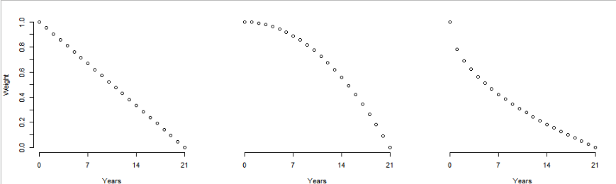
Research approach – Catchment characteristics
Annual context

Slide 27
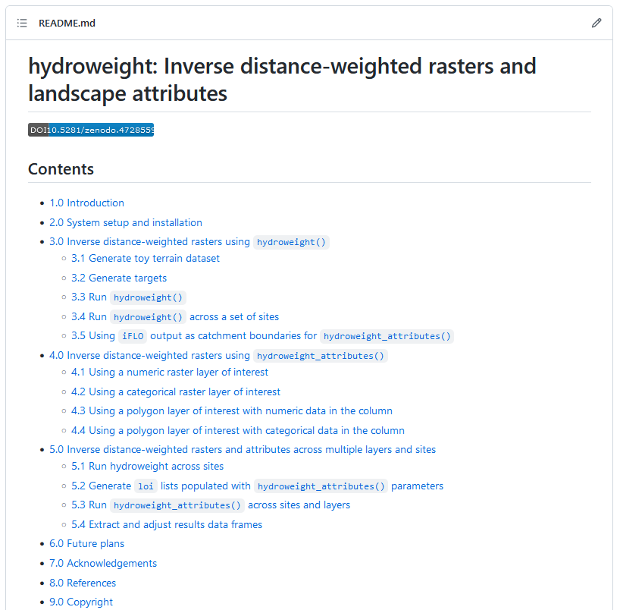
Research approach – Catchment characteristics
Weighting disturbances by different types of hydrological connections
Notes:
Link back to integrators; complex pathways from land to water and we don’t know what they are.
When I was talking about aquatic ecosystems impacted, these are pathways.

Slide 28
Research approach
Catchment characteristics (i.e., what materials? how delivered?)
Mercury concentration
Landscape context (e.g., where does the lake fit?)
Unmeasured spatial variation (i.e., what variables/scales are we missing?)
Notes:
Fish, Turn examples into questions

Slide 29
Research approach – Landscape context
Catchment
Examples of landscape context
lake area: 119 ha
lake:lakeshed area proportion: 0.08
lake:catchment area proportion: 0.01
proportion of lakes > 5 ha = 0.07
lake order: 6
Lakeshed
Lake of interest
Stream network
Upstream lakes
Notes:
30% of urban cover doesn’t lead to the same response in difference landscapes.

Slide 30
Research approach
Catchment characteristics (i.e., what materials? how delivered?)
Mercury concentration
Landscape context (e.g., where does the lake fit?)
Unmeasured spatial variation (i.e., what variables/scales are we missing?)
Notes:
Fish, Turn examples into questions

Slide 31
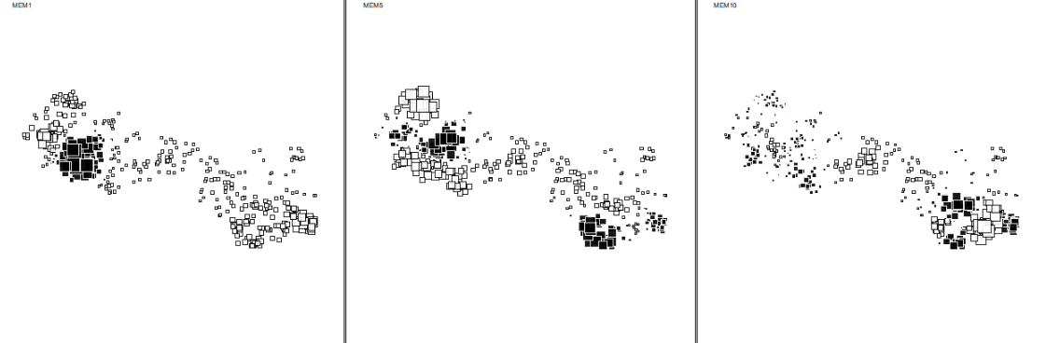
Research approach – Unmeasured spatial variation
Unmeasured spatial variation (Moran’s Eigenvector Mapping; MEM)
Roughly speaking, a Principal Coordinates Analysis on the between-lake distance matrix
Notes:
Make better figure; data nerds this is a PCA on the distances between lakes. Landscape pattern that might be influencing. Latitudinal gradients.

Slide 32
Research approach
Catchment characteristics (i.e., what materials? how delivered?)
Mercury concentration
Landscape context (e.g., where does the lake fit?)
Unmeasured spatial variation (i.e., what variables/scales are we missing?)
Notes:
Fish, Turn examples into questions

Slide 33
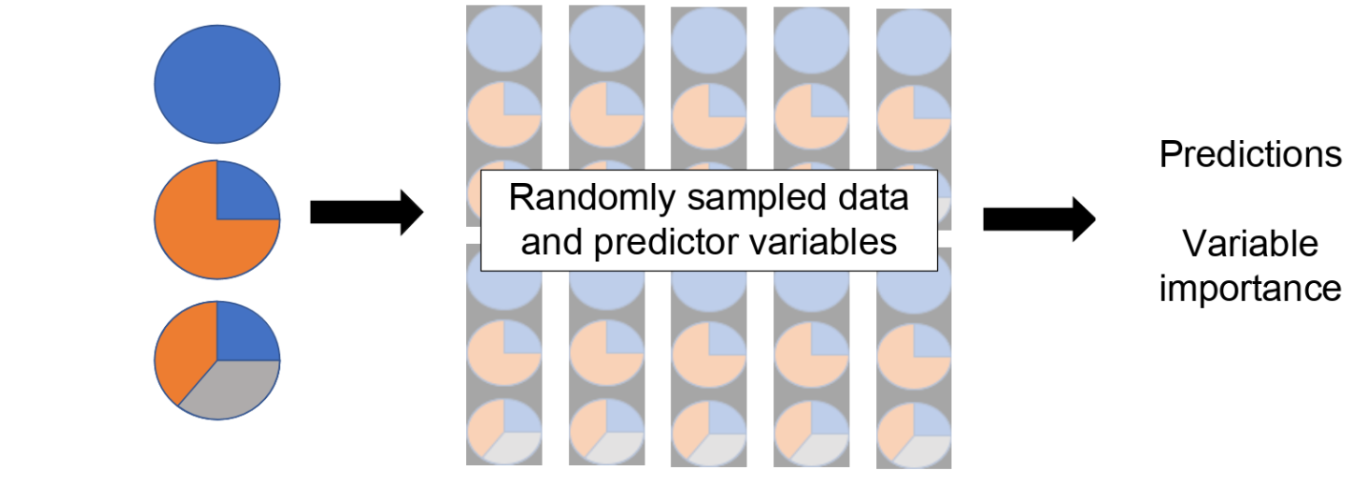
Research approach
Random forest models are cumulative effects models (Jones et al. 2017)
Employs machine learning classifier
Notes:
Random forest models; machine learning; Jones statement

Slide 34
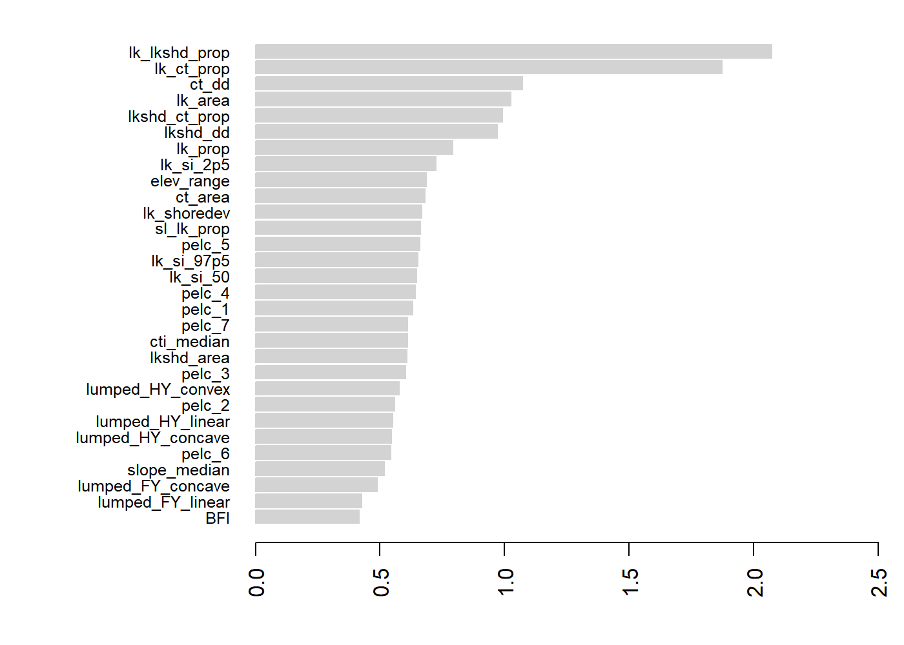
Research outcomes
Landscape context
Catchment - landform
Catchment - disturbance

Slide 35
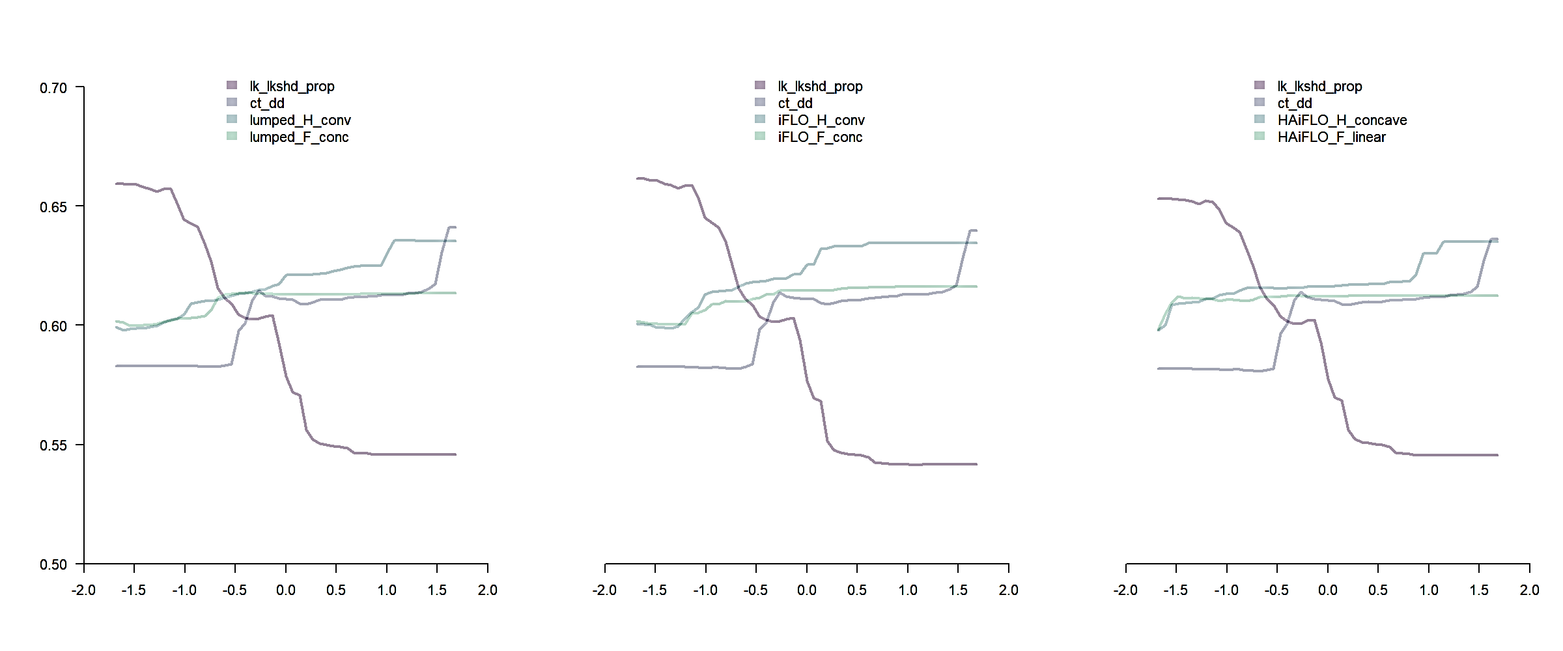
Research outcomes
“lumped” – R² = 0.58
“iFLO” – R² = 0.55
“HAiFLO” – R² = 0.58
Partial effect
All lakes
Standardized Variable

Slide 36
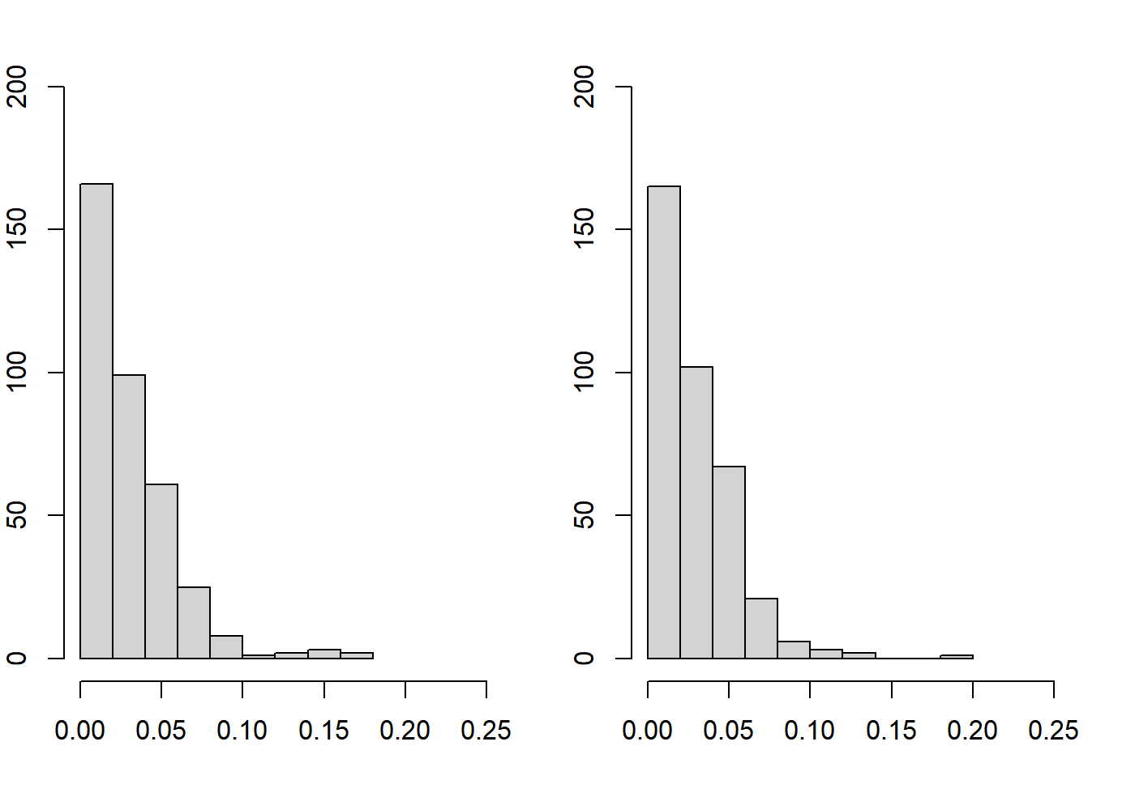
Research outcomes
Harvest Disturbance
Fire Disturbance
Catchment proportion

Slide 37
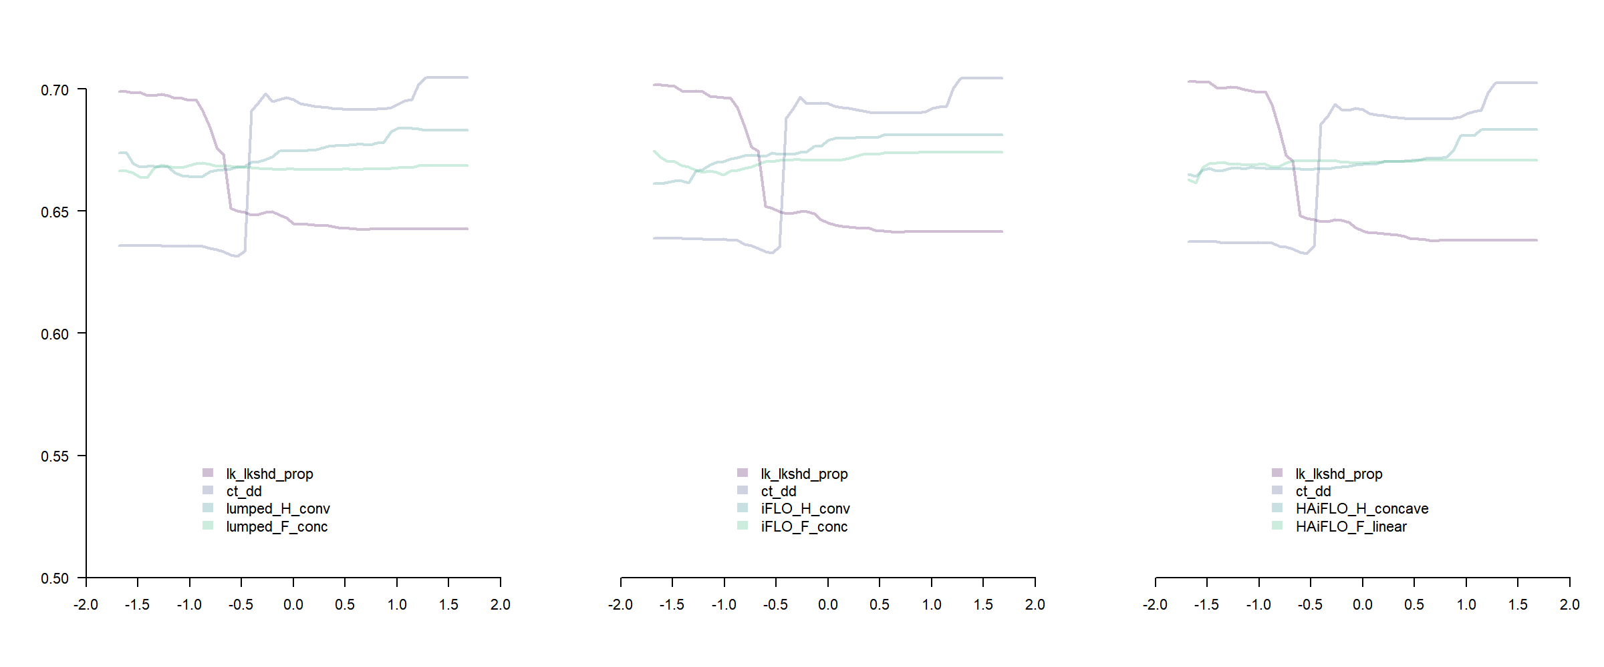
Research outcomes
“lumped” – R² = 0.58
“iFLO” – R² = 0.55
“HAiFLO” – R² = 0.58
Partial effect
Standardized Variable

Slide 38
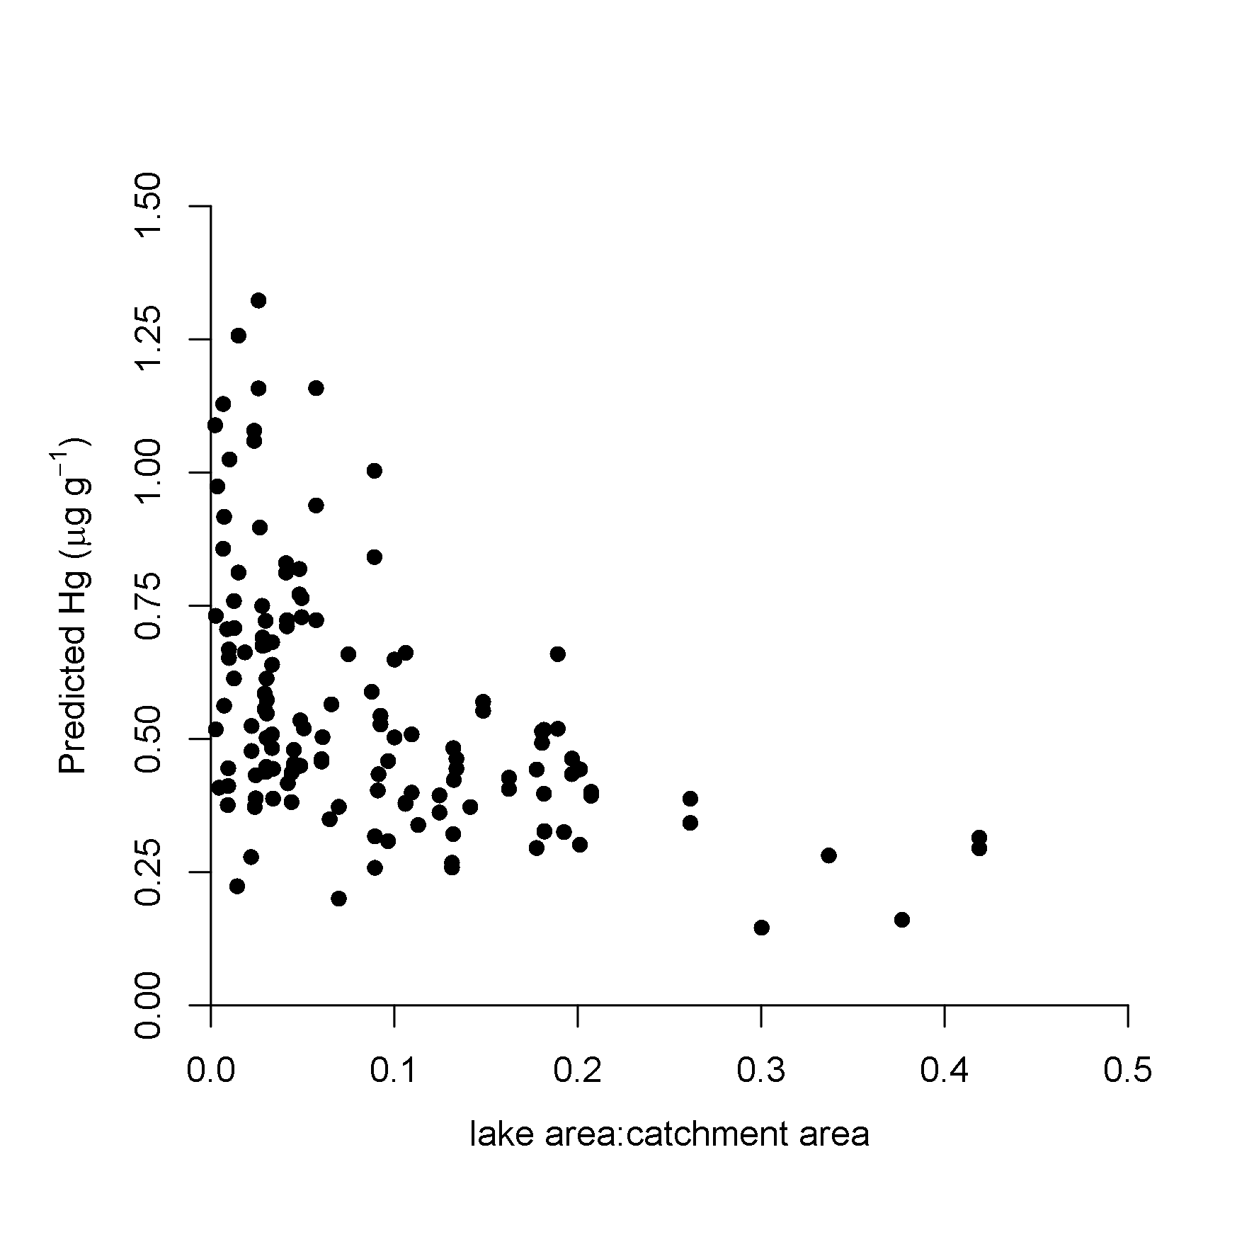
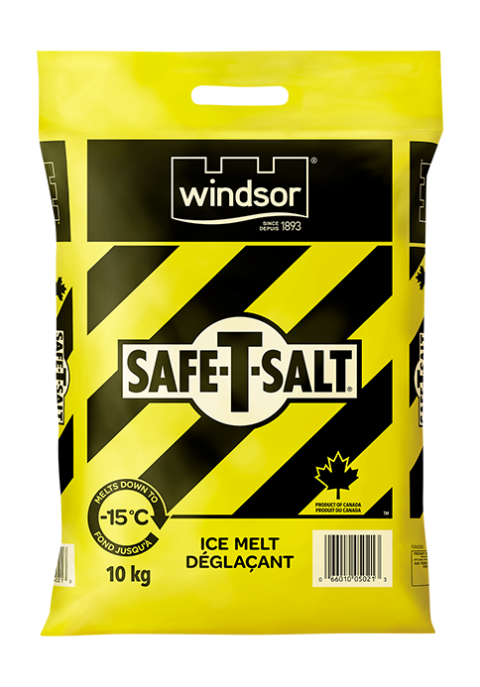
Research outcomes
i.e., very preliminary
e.g., Wet weight Hg predictions (µg/g) for median-sized Walleye across AOU lakes vs. lake area:catchment area proportion
Notes:
Main drivers to inform empirical model
Preliminary work, a lot of work, just setting the context for this.

Slide 39
Research outcomes
e.g., Wet weight Hg predictions (µg/g) for median-sized Walleye across AOU lakes vs. lake area:catchment area proportion
Notes:
Main drivers to inform empirical model
Preliminary work, a lot of work, just setting the context for this.

Slide 40
Take home and wrap up
New way of thinking about how we manage forests with cumulative effects in mind
Linking existing “off-the-shelf” data products is definitely not easy
Trying to understand the cumulative and comparative effects of disturbances and landscape factors on Hg in fish
If managing for Hg in fish, where do we put resources? Management plans? Fire? Insects?
Which catchments or parts of Ontario need to be managed differently due to different sensitivities to Hg?

Slide 41
So long and thanks for all the fish!

Slide 42
© Her Majesty the Queen in Right of Canada, as represented by the Minister of Natural Resources, 2022

Slide 43
Additional Slides

Slide 44
Research approach – Mercury concentration
How well were original data recovered?
R² = 0.80
Advantages:
Monte Carlo estimates
“Share strength” of other observations
Notes:
This is really cool☺.

Slide 45
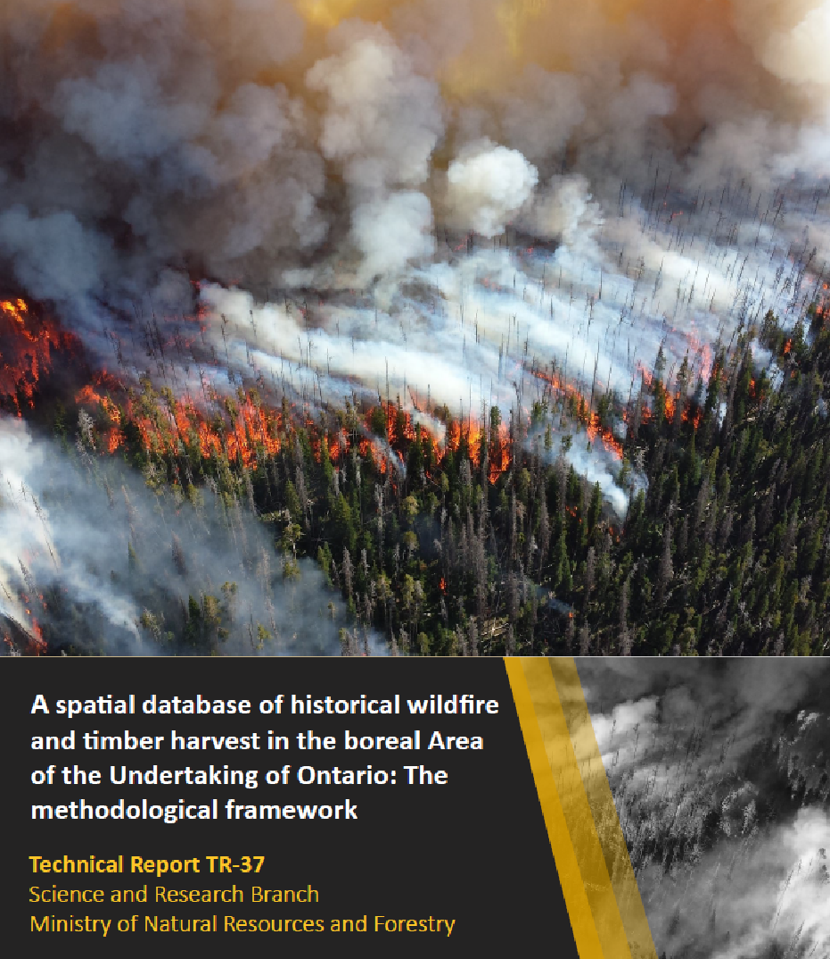
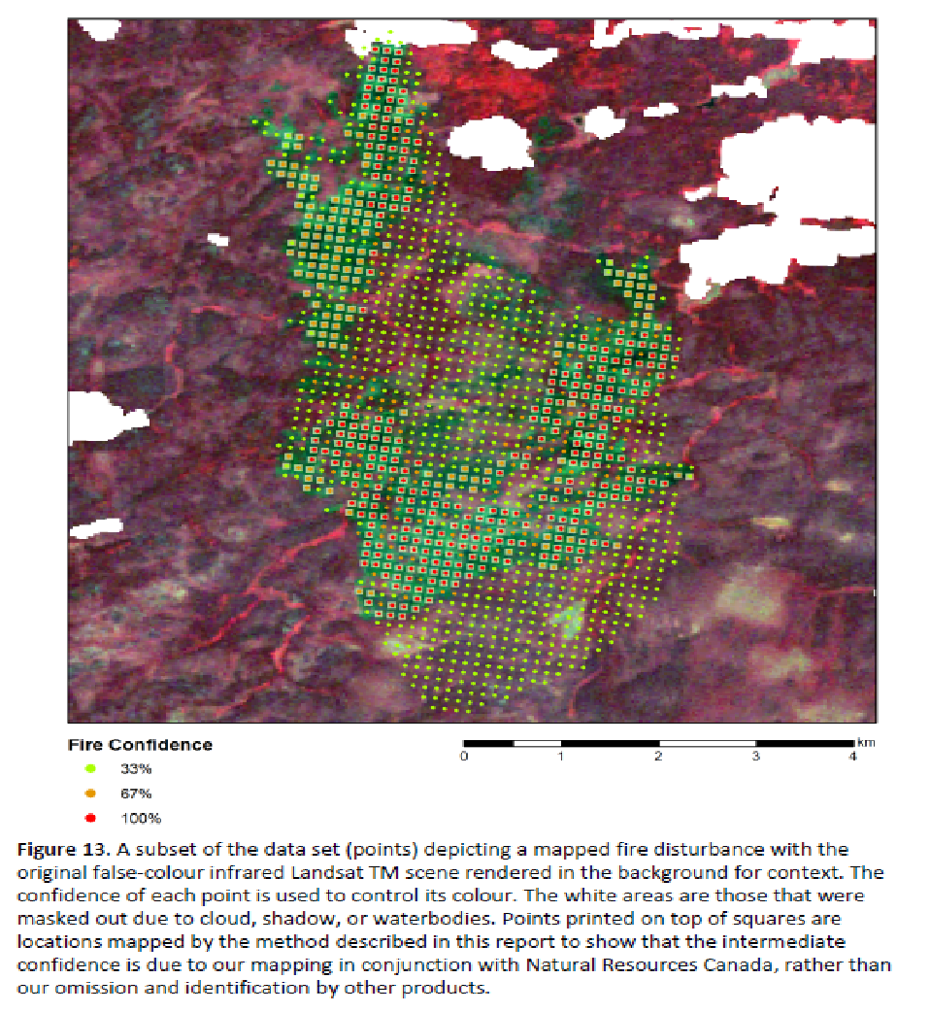
Enter Boreal Disturbance Database
Points (~1.44 ha) represent a fire/harvest disturbance
with confidence indicating agreement across input layers
Ouellette, M., T.K. Remmel and A.H. Perera. 2020. A spatial database of historical wildfire and timber harvesting in the boreal Area of the Undertaking of Ontario: The methodological framework. Ontario Ministry of Natural Resources and Forestry, Science and Research Branch, Peterborough, ON. Science and Research Technical Report TR-37. 31 p. + appendix.

Slide 46
High level overview
“The intent is to leverage its value, extend its use into new domains, and to spur productive collaborations where the common element is (minimally) this data.”
“Ultimately, users can elect to select, repackage, reassess, or use any combination of points to form clusters representing areas of disturbance, depending on their needs, biases, or to test and compare explicit assumptions”

Slide 47
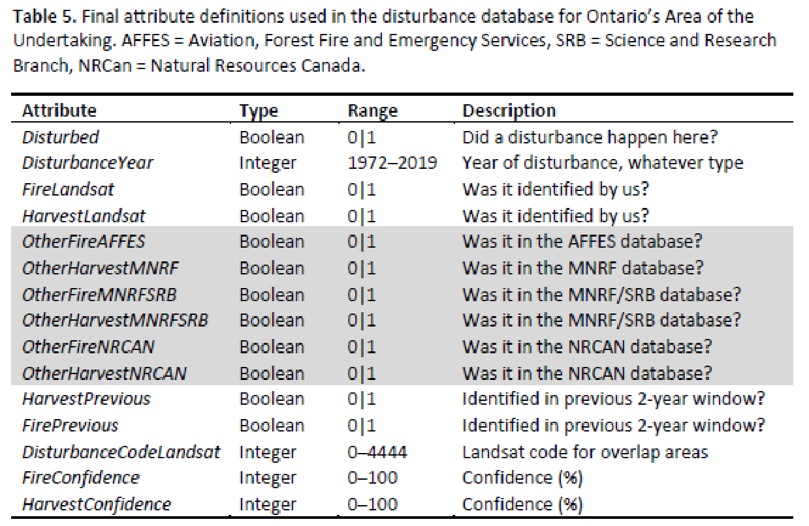
Research context – Catchment characteristics
BD1972 BD1973
… … BD2019
baseraster
BorealDisturbance.gdb

Slide 48
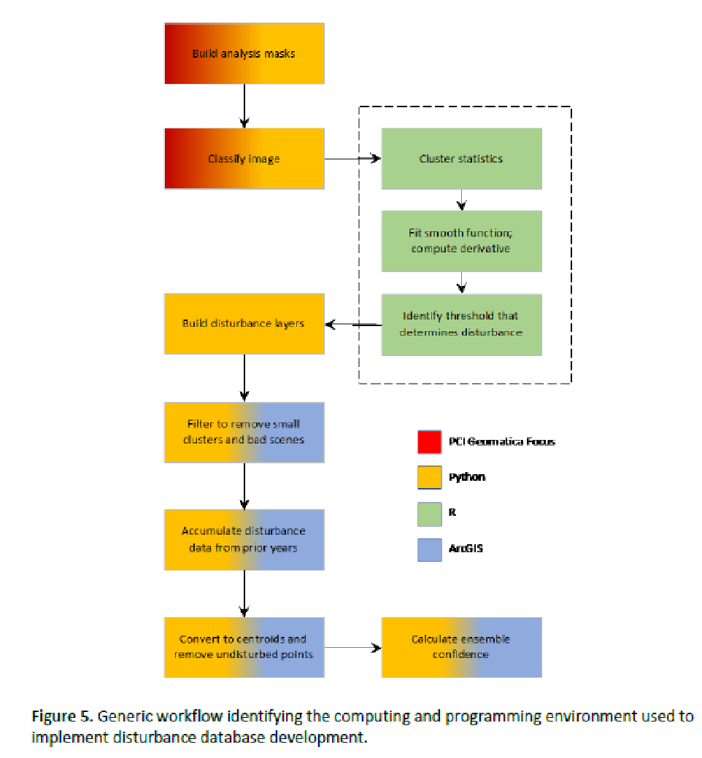
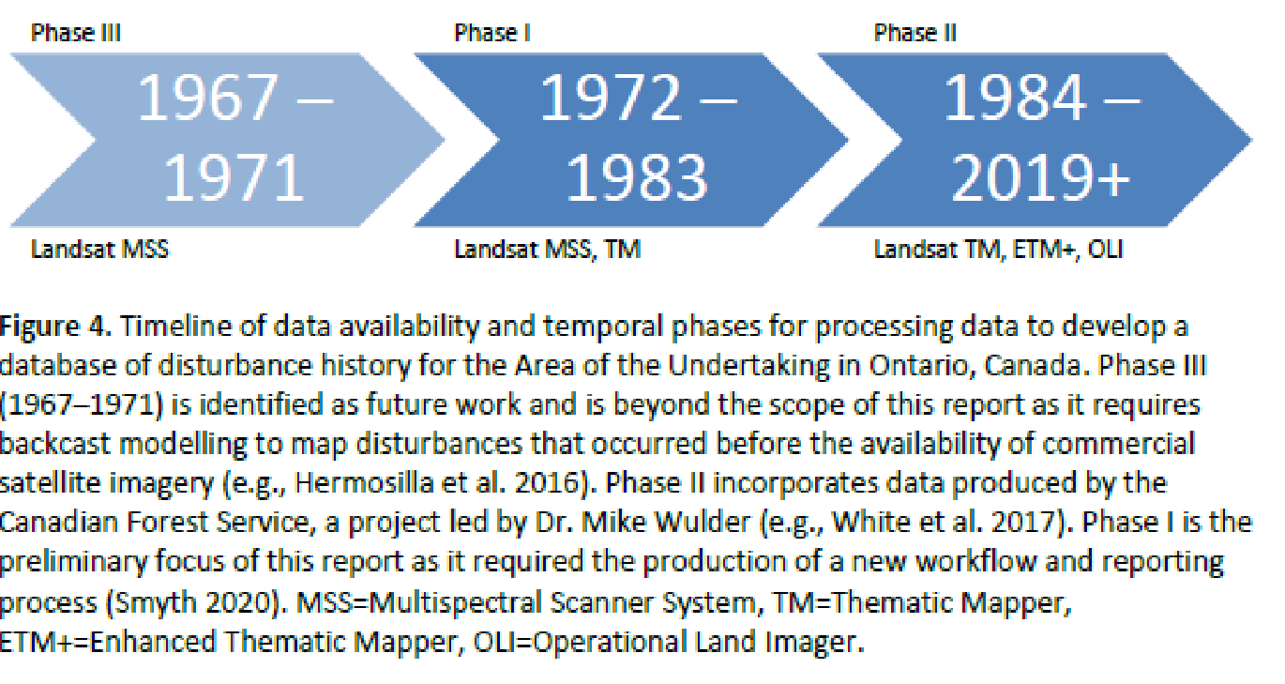
High level overview
Cut
Classify
The 8 Cs
Cluster
Combine
Clean
Check
Convert
Calculate

Slide 49
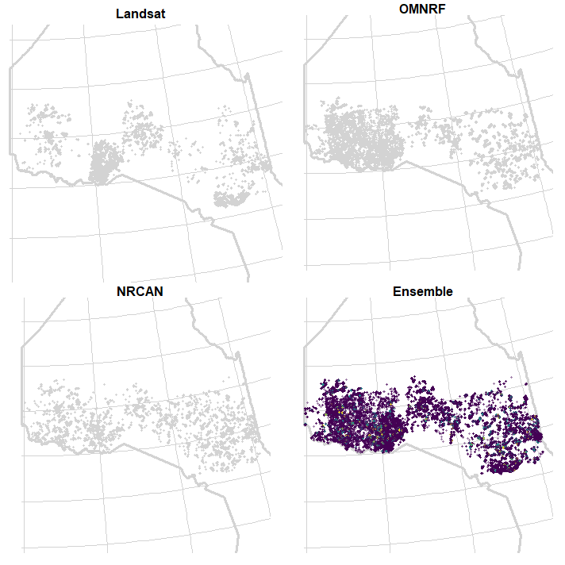
Problems to overcome
Ensemble confidence:
25 – 75%
50 – 17%
75 – 6%
100 – 0.7%
Landsat – 26%
OMNRF – 67%
NRCAN – 30%
of 2015 points
Harvest in 2015

Slide 50
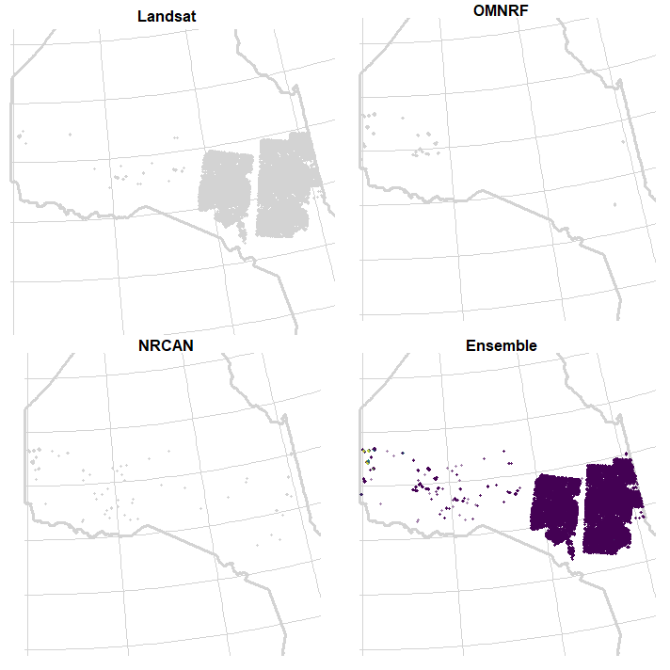
Problems to overcome
Ensemble confidence:
25 – 99%
50 – 0.3%
75 – 0.3%
100 – 0.1%
Landsat – 98%
OMNRF – 2%
NRCAN – 1%
of 2015 points
Fire in 2015

Slide 51
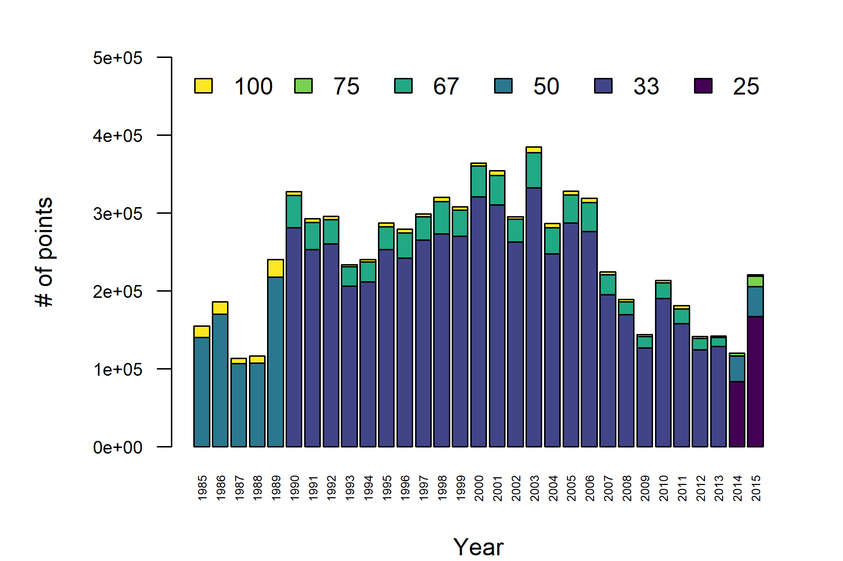
Large discrepancy in confidence, how to deal?
Harvest
# of disturbance points (1.44 ha = 1 point) across AOU dataset for different confidences. Number of categories per bar indicates number of layers used to calculate confidence.

Slide 52
Research approach – Bronze medal (exploratory)
Random forest models are cumulative effects models (Jones et al. 2017)
Hg variance₁
(Hg variance₂ + Hg variance₃ ) < Hg variance₁
(Hg variance₄ + Hg variance₅ + Hg variance₆ )< Hg variance₁
Employs machine learning classifier
Notes:
Random forest models; machine learning; Jones statement

Slide 53
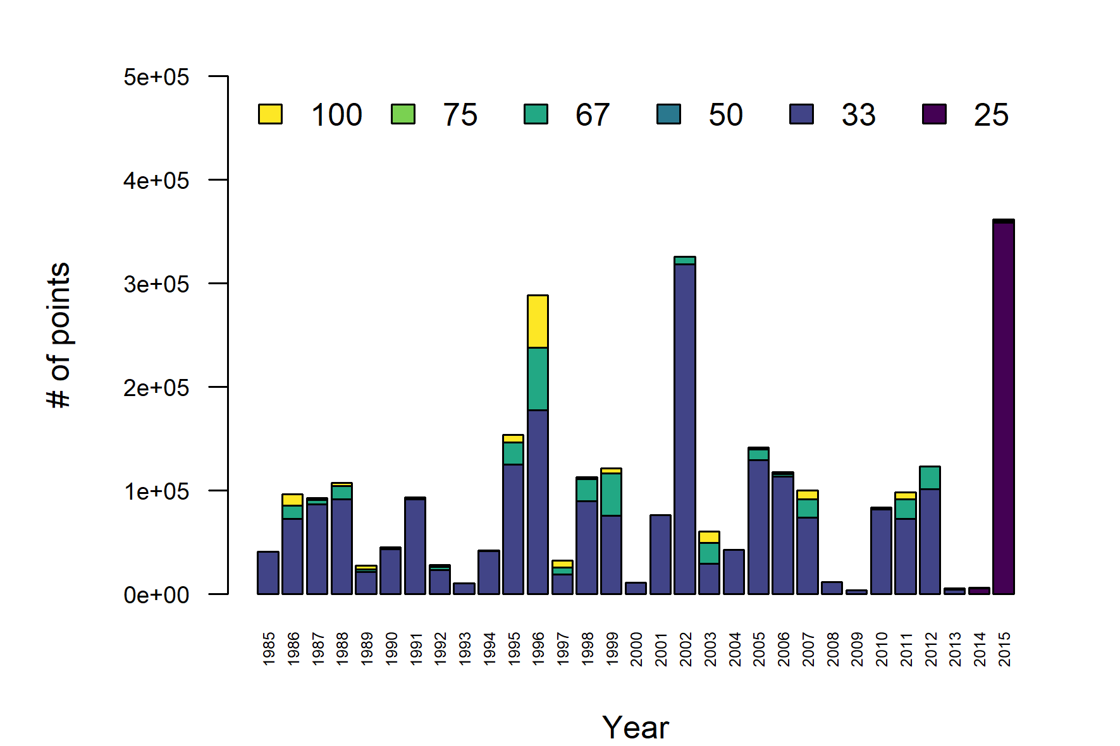
Large discrepancy in confidence, how to deal?
Fire
# of disturbance points (1.44 ha = 1 point) across AOU dataset for different confidences. Number of categories per bar indicates number of layers used to calculate confidence.

Slide 54
Research approach – landscape characteristics
Lakeshed/Catchment: compound topographic index, slope, elevation, shoreline development, landform classification, ecodistrict, wetland cover, forest cover, NDVI, NDMI, landscape disturbance metrics (spatiotemporal)
Landscape context: lake area, lakeshed area, catchment area, lake:lakeshed area, lake:catchment area, lakeshed:catchment area, geology, proportion of catchment area covered by lakes, proportion of river flowing through lakes, lake size distribution, drainage densities, lake order
Autocorrelation: MEM, AEM
Notes:
This is really cool☺.

